Slide 1
The People’s Music
Eamon Gallagher, Kevin Harmer, & Emmanuel Victor Kamya

Slide 2
Overview
Music has expanded into all areas of society. From radio to hard copy CDs to streaming to live concerts.
Despite the evolution of music accessibility, musical industries have no centralised and unbiased feedback
The People’s Music is a musical review database implementation that gives the music industry a centralized resource for any audience feedback they would need.
All artists need to do is input their music into the system and let music listeners around the world give their feedback.

Slide 3
Data Questions
Centralized Database for Music Recommendations
Diverse Mix of User’s Opinions
Gives Feedback for Artists
Compares Artists
Compares Genres

Slide 4
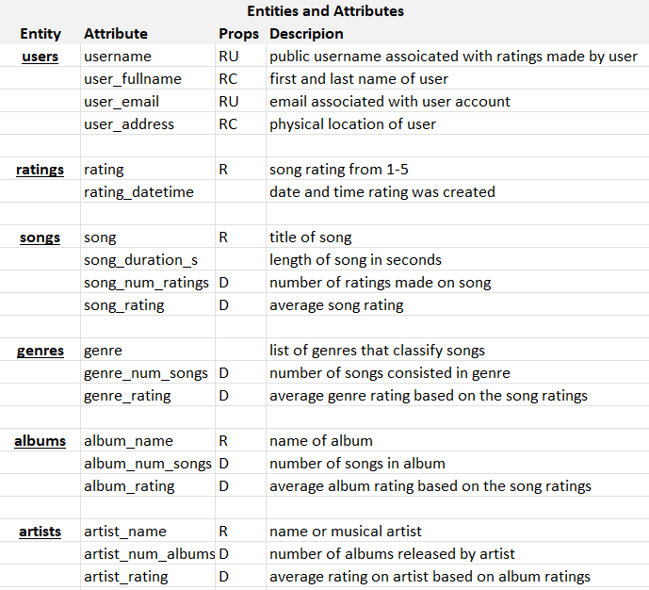
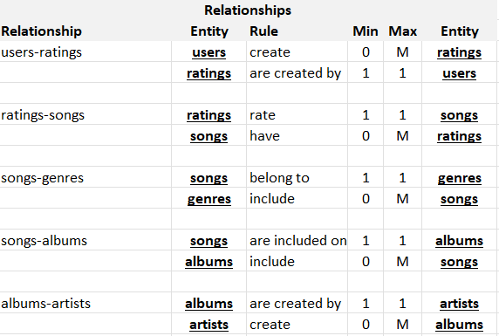
ER Requirements

Slide 5
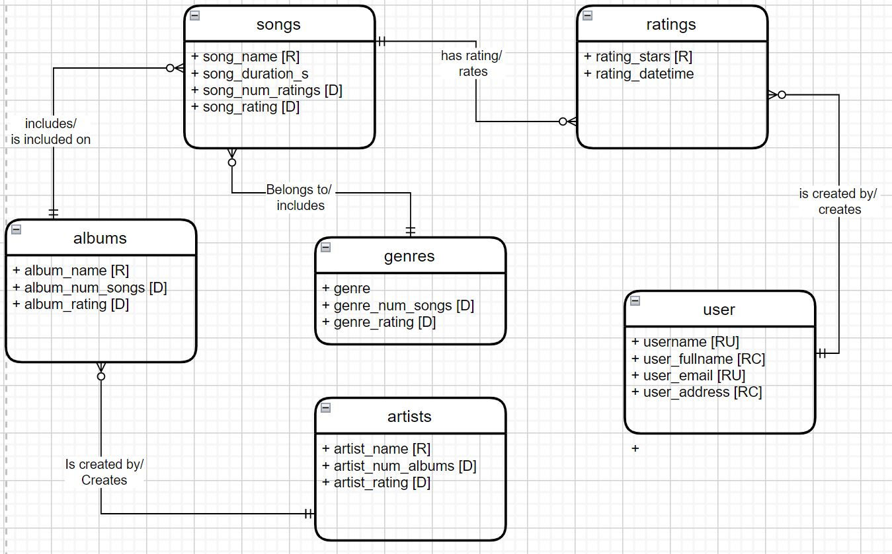
Conceptual Model

Slide 6
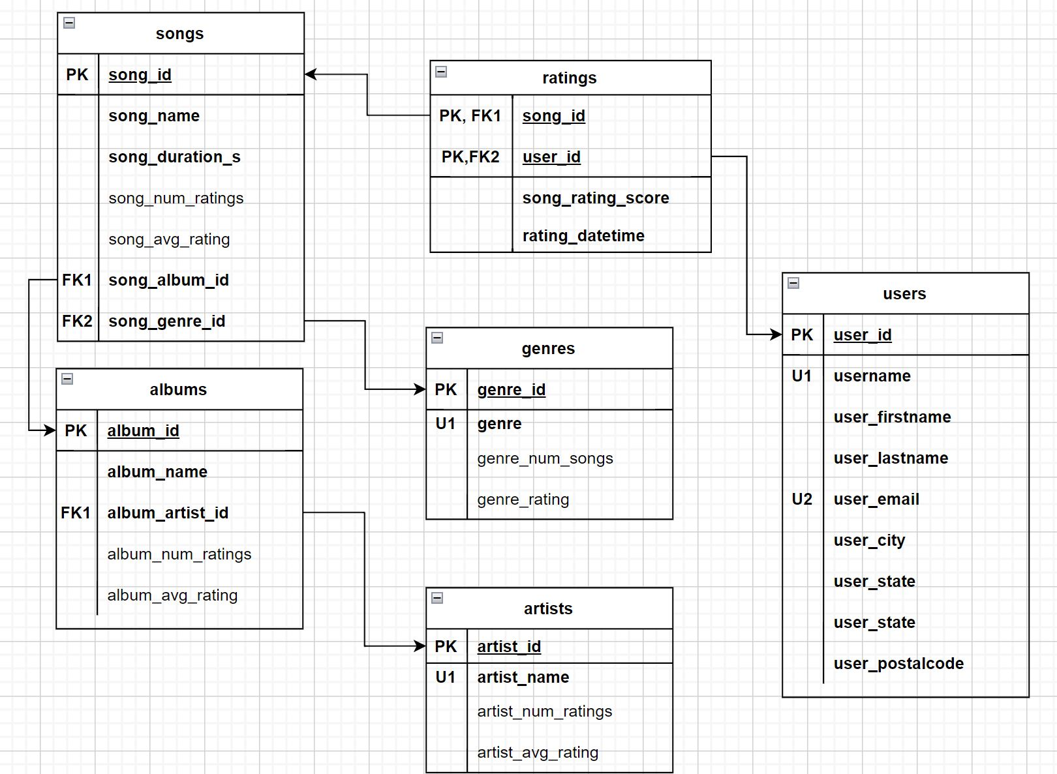
Logical Model

Slide 7
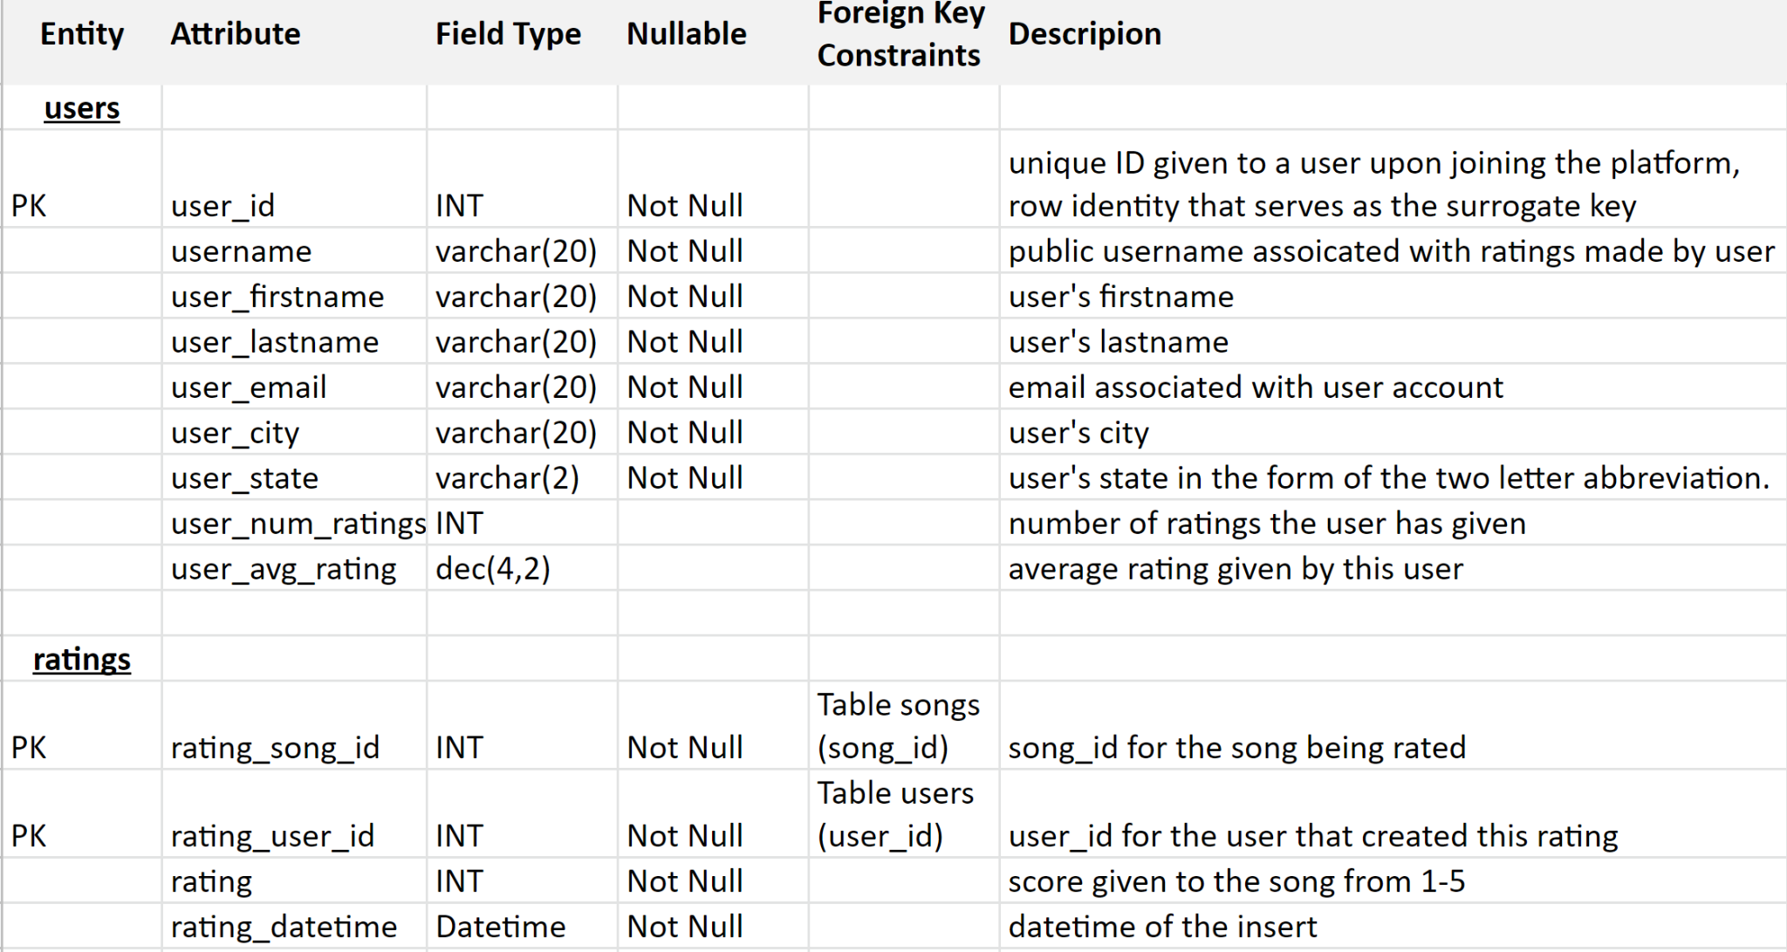
Data Dictionary

Slide 8
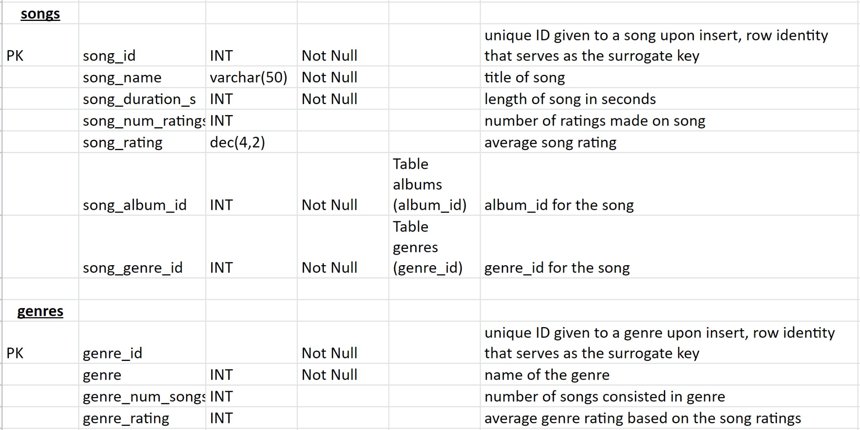
Data Dictionary Part II

Slide 9
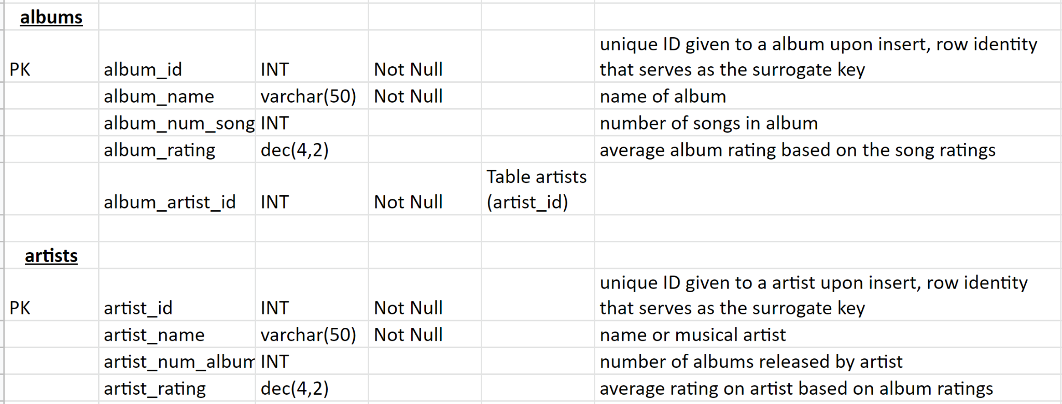
Data Dictionary Part III

Slide 10
Business Rules
All genres and artists must be unique. If one genre or artist is duplicated, there would be problems in the display of artist and genre rating.
Similar to 1., all albums must be unique for any given artist. Again, multiple inputs for the same album would cause problems in the display of album rating.
Similar to 1. and 2., all songs in an album must be unique. Each song in an album must be unique to ensure that each displayed song rating is correct.
Users can only submit one rating on each song. This can be achieved in the internal model by a composite key in the ratings table
Users can rate as many songs as they would like
Artists are rated based on their unweighted albums, meaning each album has the same impact regardless of how many ratings it has.
Albums and genres are rated based on their unweighted songs, meaning each song has the same impact regardless of how many ratings it has.
Emails can only be linked to one account
Ratings must be an integer between 1 and 5
Songs/Genres/Albums/Artists ratings have null values until a song in each category receives a rating
Music information (songs, albums, artists, and genres) are primarily inputted into the internal model while ratings and users are primarily inputted into the physical/external model.

Slide 11
Data System Infrastructure
Microsoft Excel - Excel Spreadsheets were used to create and organize the ER requirements and the Data Dictionary
Draw.io - Drawings of the Logical and Conceptual Models were made in Draw.io
Azure Data Studio - The internal model (up/down script) was constructed in Azure Data Studio. Tables and constraints were created and data was inserted to run the functionality of the database.
Database is hosted on MS Azure using the Azure portal.
Microsoft Power Apps - The database application was built in Power Apps. Data was imported into Power Apps from Azure and built into a simple functional application.

Slide 12
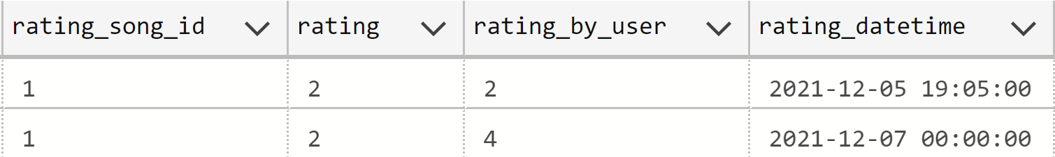
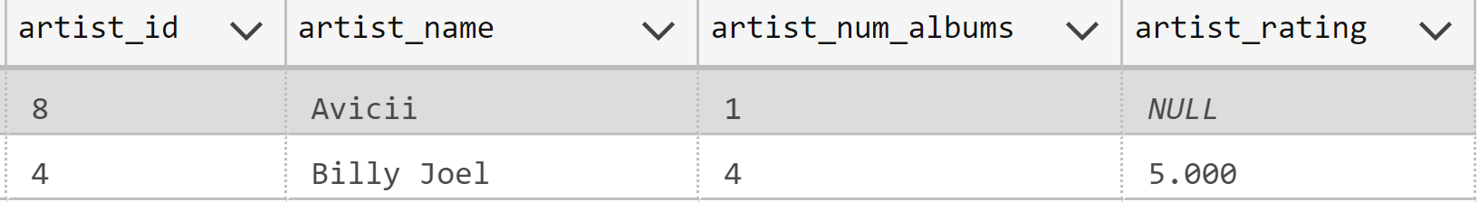
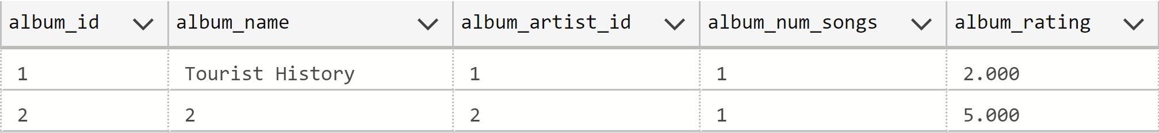

Slide 13
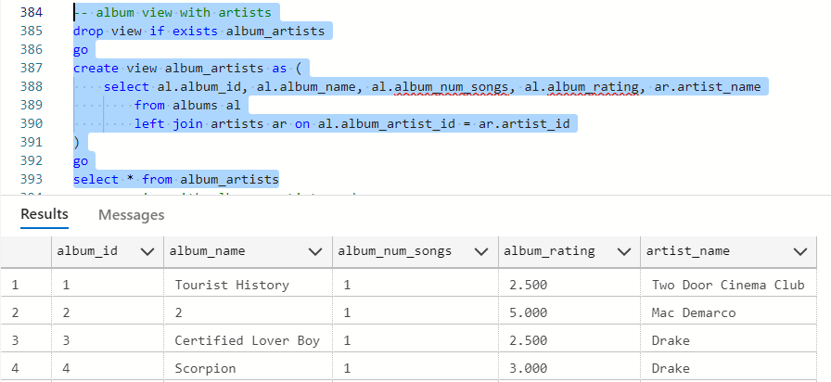
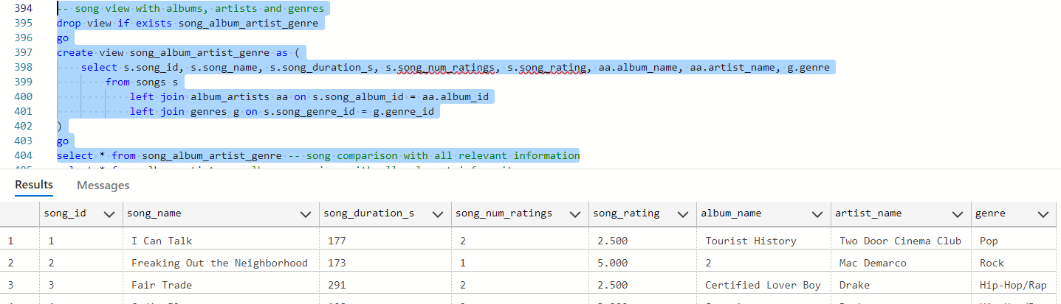
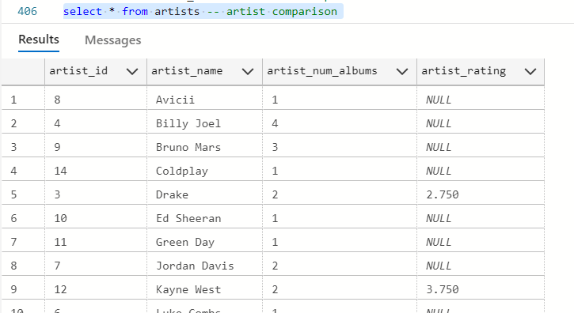
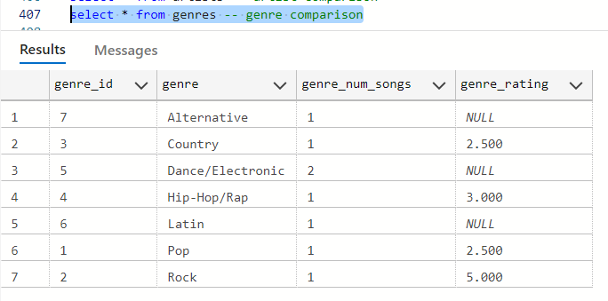
Centralized Database for Music Recommendations

Slide 14
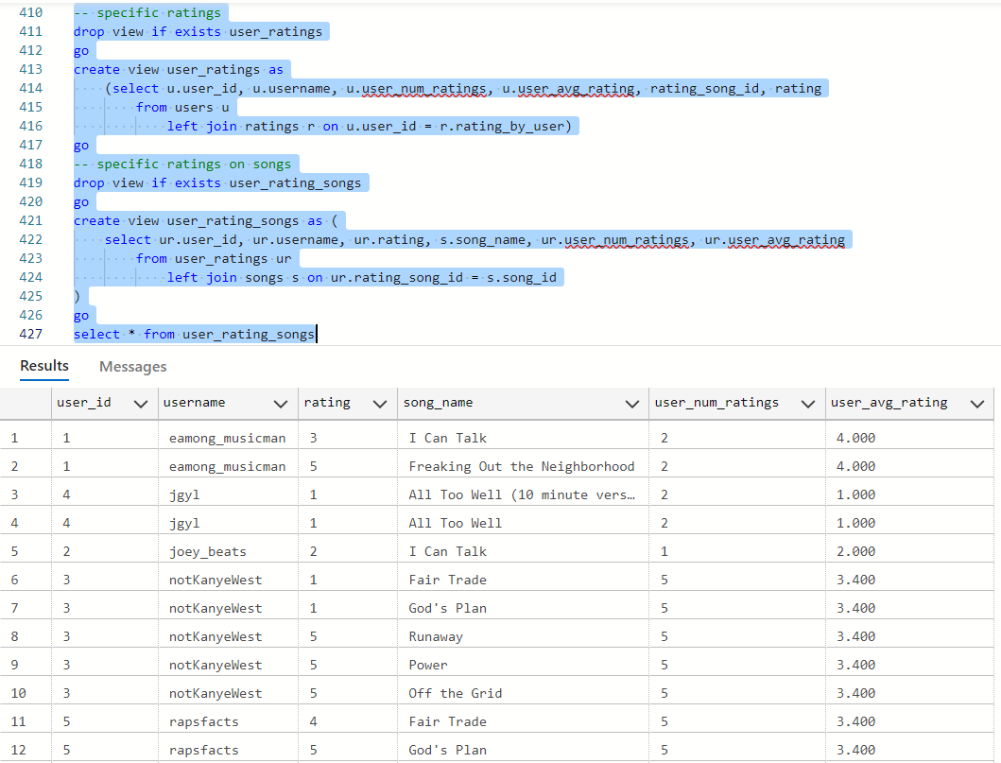
2. Diverse Mix of User Opinions

Slide 15
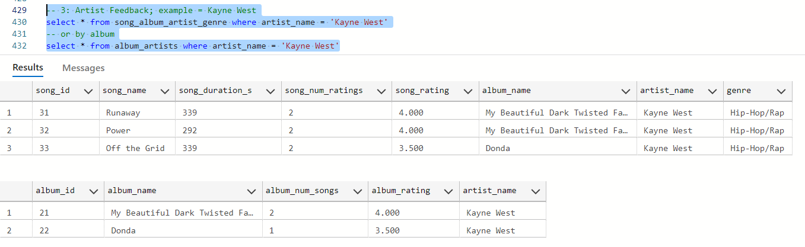
3. Gives Feedback for Artists (ex. Kanye West)

Slide 16
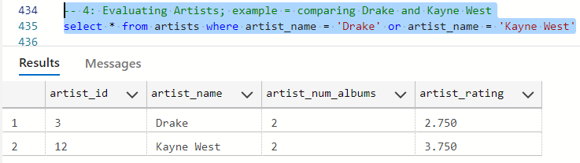
4. Comparing Artists With Each Other (ex. Kanye West and Drake)

Slide 17
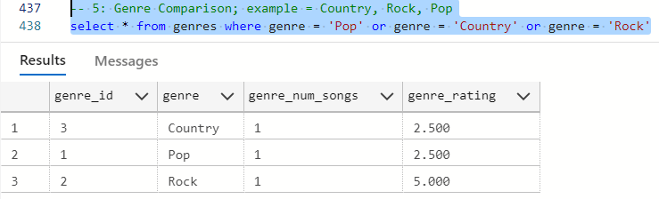
5. Genre Comparison (ex. Rock, Pop, and Country)

Slide 18
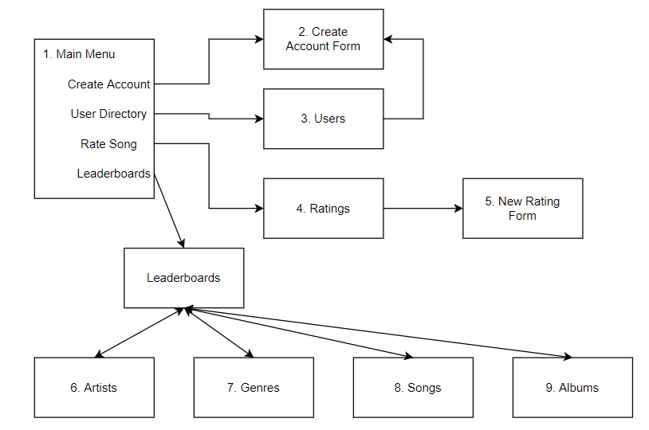
Application Diagram

Slide 19
User Stories
As a user I should be able to
Create an account
View average song rating
Rate a song
View other user accounts and account information like average rating and number of ratings given.
View artists, genres, albums and the rating associated with them.
Administrators can:
Insert new Artists, Albums for existing artists and Songs for Existing Albums.

Slide 20
Demo of The People’s Music
https://watch.screencastify.com/v/G67m6lULLpKls4kDaEwb

Slide 21
Future Explorations
Featuring artist column in songs table
Option in Application to add artists, albums and songs
Passwords for powerapp; individual user experience
Social media groups of recommendations
Inserting original album art.

Slide 22
Reflections

Slide 23
References
Song Lengths: https://www.wikipedia.org/
PowerApp: https://apps.powerapps.com/play/f018660e-0b4a-443b-b8db-d061c20c0a03?source=portal

